Slide 1


GARBAGE CLASSIFICATION USING CONVOLUTION NEURAL NETWORKS
SMART BRIDGE – REMOTE SUMMER INTRENSHIP
PROGRAM
Developed by:
TEAM- 41
K.Srividya-17UK1A05A9
D.Ravalika-17UK1A0595
E.Divya-17UK1A0569
S.Ranjith-17UK1A05A3

Slide 2
INTRODUCTION
Garbage is defined as the items or materials that need to be discarded because they no longer serve any purpose for us or are of no use to us.
This classification is needed to know and apply reuse methods that could bring beneﬁts and reduces the environmental problems by the garbage. Now-a-days the existence of techniques or models that help people to sort garbage has become essential in the correct dispose of those materials .
The objective of this project is to take images of a single piece of recycling or garbage and classify it into four classes consisting of glass, metal, paper, plastic. We create a dataset that contains around 250 images for each class.
Convolutional Neural Network model which is a machine learning tool and serves as the extractor, which is used to classify the garbage into different groups/types such as glass, metal, paper, and plastic etc. The separation process of the waste will be faster and intelligent using the proposed waste material classification system without or reducing human involvement.

Slide 3
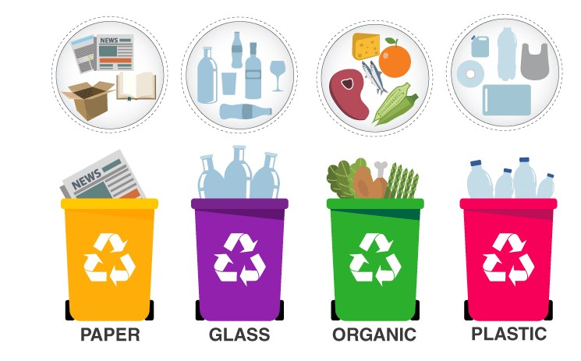

Slide 4
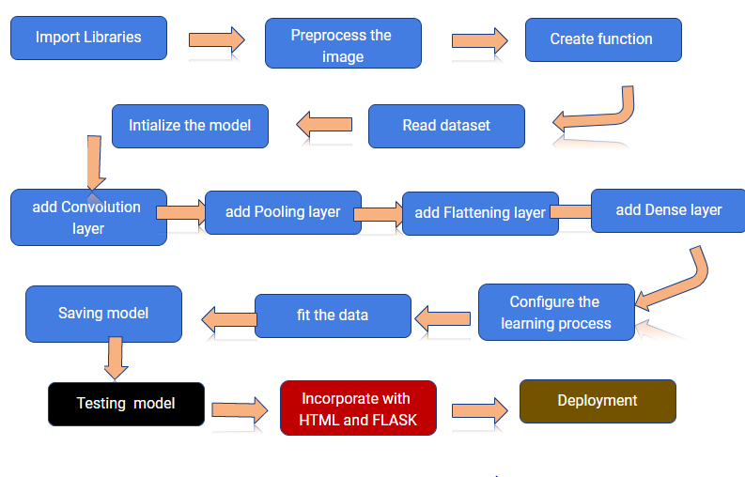
BLOCK DIAGRAM:

Slide 5
ADVANTAGES:
CNN represent current state of art techniques in image classification.
This program helps to reduce the exposure of harmful germs and chemicals to garbage pickers.
It provides better control over odour and noise.
I t is effective for recycling of glass ,metal , paper and plastic.
I t helps in reduction of pollution
DISADVANTAGES:
The runtime of convolution operations are computalationally high.
Large number of training data and annotations are needed ; which maynot be practical in some problems.
From a memory and capacity standpoint the CNN is not much bigger than regular two layer network.

Slide 6
APPLICATIONS:
It mainly applies for image recognition of garbage and helps to classify garbage into glass, metal, paper and plastic.
This garbage classification system can take short time to sort the garbage .
It will be more accurate than sorting of garbage products by manual way.
Open source libraries for deploying application in CNN is very fast.
This application improves the fuctioning of corporations which are involved in garbage collection.

Slide 7
CONCLUSION:
Through this research, we obtained the accuracy above 87% and made the comparative analysis on the model we adapted to train our data.
For this, we have been putting a continuous effort for getting better result for each evaluation metrics.
Furthermore, we still have things to work on dataset and increase its number. Also, t he performance of model can be improved further by increasing the number of i mages and fine tuning the model properly.
The idea of garbage classification can be send in recycling process of waste if the mode is reliable and more accuracte.

Slide 8
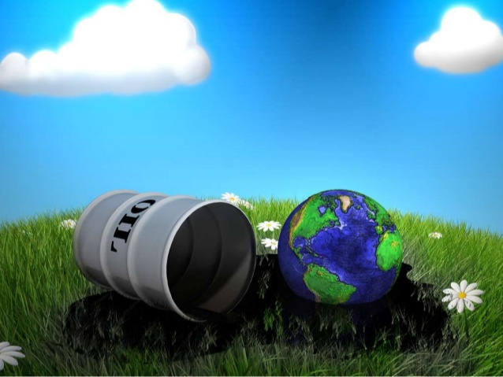
THANK YOU

